Slide 1
BCSE498J Project-II
Early Warning System for Lifestyle-Related Health Risks Using Text Analytics
Team Members
Supervisor
Institution
Abhay Singh (22BCE0490)
Dr. Yoganand S
School of Computer Science and Engineering (SCOPE)
Manas Joshi (22BCE2573)
Assistant Professor Sr. Grade 1
Vellore Institute of Technology, Vellore
Yagnit Mahajan (22BCE2588)
February 2026

Slide 2
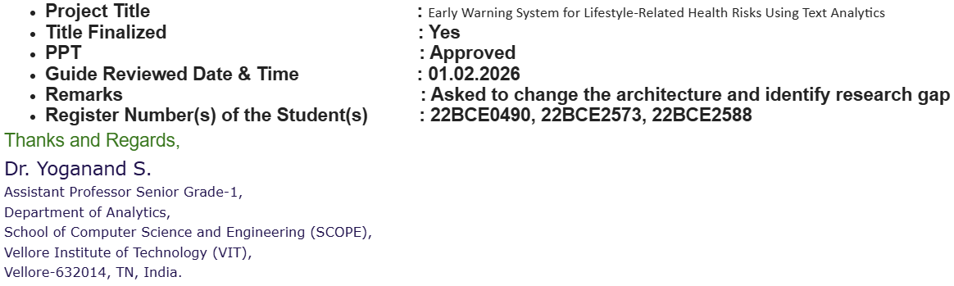
01
03
04
06

Slide 3
Contents
01
Introduction
02
Project Description & Goals
Background, motivations, and project scope
Literature review, gaps, objectives, and planning
03
Requirements & Specifications
04
Design Approach & Details
Functional and non-functional requirements
System architecture and design methodology
05
Methodology & Testing
06
Key Insights & Impact
Data analysis, preprocessing, and evaluation
Conclusions and project significance

Slide 4
Chapter 01
Introduction
Background, motivations, and scope of the early warning system project
Background
Motivation
Scope

Slide 5
1.1 Background
The Growing Challenge
Lifestyle-Related Health Crisis
Key Risk Factors
Lifestyle-related health problems are increasing day by day. Conditions such as diabetes, obesity, heart disease, and high blood pressure are mainly caused by poor food habits, lack of exercise, improper sleep, and high stress.
Poor food habits
Lack of exercise
Improper sleep patterns
Most of these diseases do not appear suddenly—they develop slowly over time and often show no clear symptoms in early stages, making early detection critical.
High stress levels
Excessive screen time
Smoking and alcohol
Current Healthcare Gap
Untapped Data Source
Healthcare systems focus on treating diseases after they occur. Regular checkups happen only when people feel unwell, causing early signs of unhealthy habits to be ignored.
A large amount of useful health information exists in text form—lifestyle surveys, daily health notes, and self-reported habits—that remains underutilized for risk detection.
Our Solution
Machine learning and text analysis can study lifestyle data and find patterns related to health risks, enabling early identification and timely action.

Slide 6
1.2 Motivation
Why This Project Matters
Preventive Healthcare Need
Academic Opportunity
The primary motivation is the growing need for preventive healthcare solutions that focus on early detection rather than delayed treatment. Lifestyle diseases place significant burden on individuals and healthcare systems in terms of cost and long-term complications.
This project provides an opportunity to apply concepts of machine learning, text analytics, and data preprocessing to a real-world healthcare problem. The increasing availability of lifestyle data and rapid growth of AI in healthcare make this domain both relevant and challenging.
Early identification enables timely lifestyle modifications
Bridges theoretical knowledge and practical implementation
Healthcare Trends
Social Impact
Current trends emphasize personalized and data-driven approaches. An intelligent system capable of analyzing lifestyle patterns and generating early warnings aligns perfectly with these trends.
The project is motivated by the goal of contributing to proactive health management and exploring how technology can support individuals in maintaining healthier lifestyles through accessible, understandable insights.
Supports proactive health management
Empowers individuals with early awareness

Slide 7
1.3 Scope
Project Scope
What the System Does
Explicitly NOT Included
The scope is limited to developing an early warning system that analyzes lifestyle-related text data to predict possible health risks. The system focuses on factors such as food habits, physical activity, sleep patterns, and stress-related information provided by users in text form.
Medical Diagnosis
Does not provide clinical diagnosis or treatment recommendations
Real-time Sensors
No integration with medical devices or wearable sensors
Data Collection
Text Cleaning
Clinical Treatment
Gathering lifestyle text data
Preprocessing and normalization
Not a replacement for professional medical care
Feature Extraction
Model Training
Identifying key patterns
ML-based classification
Core Components
Important Notes
Food Habits
Physical Activity
Sleep Patterns
Stress Levels
System is a support tool for health awareness
Results may vary based on data quality and size
Limitations are considered within scope

Slide 8
Chapter 02
Project Description
and Goals
Literature review, identified gaps, objectives, and project planning
Literature Review
Research Gaps
Objectives

Slide 9
2.1.1 Literature Review
Traditional ML Approaches
Overview
Traditional machine learning techniques have been widely used for predicting lifestyle-related diseases due to their effectiveness with structured health data. These approaches are particularly suitable for tabular lifestyle features such as dietary habits, physical activity levels, sleep duration, and body mass index.
Models Used
Performance
Interpretability
Logistic Regression
AUC Range
0.82 - 0.88
Traditional ML models provide interpretable feature importance measures, which support clinical validation and decision-making.
Random Forests
Diabetes & CVD prediction
Support Vector Machines
Ensemble Methods
Ensemble models consistently outperform individual classifiers by capturing complex, non-linear relationships
Feature-level insights
Key Limitations
Manual feature engineering requires extensive domain expertise
Performance degrades with unstructured text data

Slide 10
2.1.2 Literature Review
DL and NLP Based Approaches
Advanced Pattern Recognition
Deep learning and NLP techniques enable more advanced risk prediction by extracting latent health patterns from unstructured and high-volume data sources. Unlike traditional ML, DL architectures can automatically learn hierarchical representations without extensive manual feature engineering.
Hybrid Models
Transformer Models
Multimodal Fusion
CNN-LSTM combinations successfully applied for mental health, stress, and depression screening using short-text and time-series inputs.
BERT-based models improve disease risk prediction by capturing contextual information from free-text electronic health records.
Integration of lifestyle time-series data with textual embeddings demonstrates promising results in real-time prediction systems.
Mental health screening
AUROC: +5-10%
Sepsis prediction
Stress detection
vs. baseline models
Cardiac arrest detection
Data Sources
Clinical Notes
Social Media
Patient Diaries
Wearable Data

Slide 11
2.1.3 Literature Review
Explainable AI in Healthcare
Transparency and Trust
Explainable Artificial Intelligence (XAI) plays a critical role in addressing transparency and trust issues associated with black-box predictive models in healthcare. For preventive systems, clinicians require clear explanations of how lifestyle factors influence predicted risk scores.
XAI Techniques
Clinical Applications
xAI-EWS Systems
SHAP
SHapley Additive exPlanations
Explainable early warning with trend-based explanations
Feature-level attributions highlighting contribution of variables
SpinachXAI-Rec
Multi-stage framework tracing dietary recommendations
LIME
Local Interpretable Model-agnostic Explanations
Clinical Validation
Local explanations for individual predictions
Improved clinician confidence and usability

Slide 12
2.2 Gaps Identified
Research Gaps Identified
Comprehensive analysis of existing research reveals critical limitations across different approaches. While studies focus on specific aspects—structured data, clinical EHR, mental health, or sentiment analysis—none connect user-generated text to lifestyle-related physical health risks with interpretable scoring.
Structured Data Focus
Mental Health Only
Adlakha et al. (2025)
Cardamone et al. (2025)
Focus: Diabetes prediction using BMI, age, dietary type
Focus: EHR text for mental health prediction
Limitation: No unstructured lifestyle information
Limitation: Limited to clinical environments
Liu et al. (2025)
Research Team (2022)
Focus: Clinical notes with advanced NLP
Focus: Depression detection from social media
Limitation: Less effective for informal social media text
Limitation: No link to physical health risks
Our Solution
Reddit text for behavioral information
NLP for lifestyle risk signals
Interpretable composite risk score
Combines sentiment + lifestyle indicators

Slide 13
2.3 Objectives
Project Objectives
01
Data Collection & Preprocessing
02
Feature Extraction
Collect and preprocess user-generated text data from Reddit related to lifestyle factors such as stress, diet, and sleep habits.
Extract meaningful textual features, including sentiment analysis and lifestyle-related keywords, from the collected Reddit posts.
Publicly available Reddit posts
Sentiment polarity detection
Multiple lifestyle categories
Keyword identification
Cleaning and normalization
Text statistics and metrics
03
Risk Score Computation
04
User Interface Design
Compute a simple and interpretable lifestyle risk score based on the extracted text features from user discussions.
Design and implement a basic frontend user interface that displays the risk score and key contributing factors.
Rule-based scoring mechanism
Intuitive visual design
Low/Moderate/High classification
Risk visualization
Transparent calculation
Factor explanation display

Slide 14
2.4 Problem Statement
Problem Statement
Core Problem
Required Solution
Lifestyle-related diseases are often influenced by daily habits, stress levels, and behavioral patterns that are not always captured through structured health records. While many existing approaches rely on clinical or numerical data, user-generated text from online platforms remains underutilized for lifestyle risk assessment.
1
Text Analysis Capability
Process unstructured social media content
2
Lifestyle Risk Detection
Identify patterns in daily habits and behaviors
3
Interpretable Scoring
Therefore, there is a need for a simple and interpretable approach that can analyze social media text to identify lifestyle-related risk indicators and provide an understandable risk score that supports early awareness rather than clinical diagnosis.
Explainable risk assessment
4
Early Awareness Focus
Support prevention, not diagnosis
Key Insight
Structured Data Gap
Text Data Underutilized
Lack of Interpretability
People reveal subtle clues about their routines through daily writing—feeling tired, screen time, food choices—that can indicate emerging health risks when analyzed systematically.
Missed behavioral context
Rich lifestyle information
Black-box predictions

Slide 15
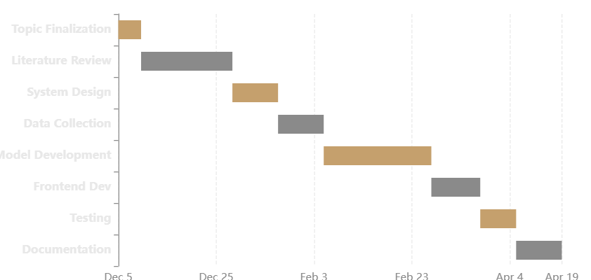
2.5 Project Plan
Project Plan and Timeline
Development Approach
Phase Breakdown
The project is carried out in clear and manageable phases to keep development organized and easy to evaluate. Each phase builds on previous results, ensuring smooth integration and steady progress.
1
Topic Finalization & Review 1
Dec 05 - Dec 11 (7 days)
2
Literature Review & Gap Analysis
Dec 12 - Jan 08 (28 days)
3
System Design (HLD & LLD)
Project Timeline (Gantt Chart)
Jan 09 - Jan 22 (14 days)
4
Data Collection & Preprocessing
Jan 23 - Feb 05 (14 days)
5
Model Development & Analysis
Feb 06 - Mar 10 (33 days)
6
Frontend Development
Mar 11 - Mar 25 (15 days)
7
Testing & Evaluation
Mar 26 - Apr 05 (11 days)
8
Documentation & Submission
Apr 06 - Apr 19 (14 days)

Slide 16
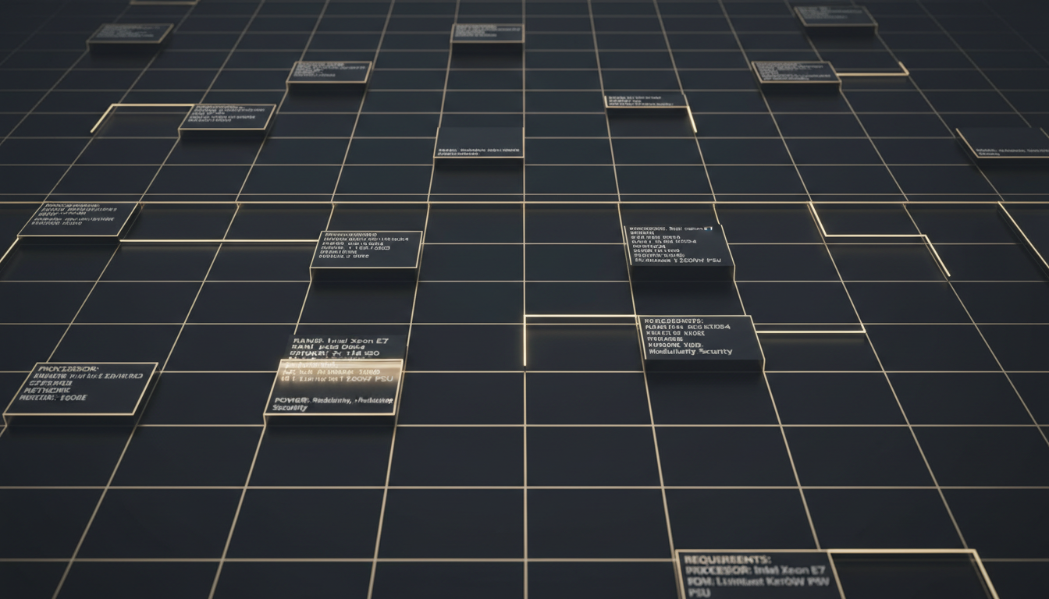
Chapter 03
Requirements and
Specifications
Functional and non-functional requirements, feasibility study, and system specifications
Requirements
Feasibility
Specifications

Slide 17
3.1.1 Requirements
Functional Requirements
01
Data Collection
02
Text Preprocessing
03
Sentiment Analysis
04
Keyword Identification
The system shall collect publicly available text data from Reddit related to lifestyle and health discussions.
The system shall preprocess the collected text by performing cleaning, tokenization, stopword removal, and lemmatization.
The system shall analyze the sentiment of the input text to determine the emotional tone (positive, neutral, or negative).
The system shall identify lifestyle-related keywords such as sleep issues, stress, diet habits, smoking, and alcohol consumption.
PRAW API integration
NLTK-based pipeline
Polarity detection
TF-IDF extraction
05
Risk Score Computation
06
Risk Classification
07
Explainable Output
08
User Interface
The system shall compute a lifestyle risk score using a rule-based scoring mechanism combining multiple features.
The system shall classify the risk level as Low, Moderate, or High based on the computed score.
The system shall generate an explainable output indicating the factors contributing to the risk score.
The system shall display the analysis results through a simple frontend user interface for easy interpretation.
Composite scoring
Three-tier system
Feature attribution
React-based UI

Slide 18
3.1.2 Requirements
Non-Functional Requirements
Usability
Performance
Scalability
The system should provide a simple and easy-to-understand user interface suitable for non-technical users.
The system should analyze and generate results within an acceptable time for small to medium-sized text inputs.
The system should be capable of handling an increased number of text inputs with minimal modification.
Intuitive design
Fast processing
Modular architecture
Clear visualizations
Real-time feedback
Easy expansion
Reliability
Explainability
Security & Ethics
The system should produce consistent and repeatable results for the same input data.
The system should clearly explain how the lifestyle risk score is calculated to ensure transparency.
The system should use only publicly available data and ensure ethical handling of user-generated content.
Deterministic output
Feature attribution
Privacy protection
Stable performance
User-friendly explanations
Ethical compliance

Slide 19
3.2 Feasibility Study
Feasibility Analysis
Technical
Economic
Social
Well-Established Technologies
Open-Source Tools
Health Awareness
Python-based NLP libraries (NLTK) with proven reliability
Python, NLP libraries, and frontend frameworks are free
Promotes awareness of lifestyle-related health risks
Reliable Data Access
Public Data Sources
Privacy Protection
PRAW library provides documented Reddit API access
Reddit data collection eliminates acquisition costs
Uses only publicly shared data, no personal intrusion
Modular Architecture
Standard Computing
Non-Diagnostic
Each component can be developed and tested independently
Personal computers sufficient, no additional hardware
Explainable output helps users understand risk factors
Standard Hardware
No License Fees
Ethical Responsibility
No specialized equipment required
All software freely available
Supports positive health awareness
FULLY FEASIBLE
MINIMAL COST
SOCIALLY BENEFICIAL

Slide 20
3.3 Specification
System Specifications
Hardware
Software
The proposed system can be developed and executed on a standard personal computer. No specialized hardware such as GPUs or external devices is required.
The system is implemented using Python as the primary programming language with modern web technologies for the frontend and backend.
RAM
Python
8 GB Minimum
Primary programming language
NLTK
Processor
Text preprocessing & sentiment analysis
Intel i5 or Equivalent
PRAW
Reddit data collection API
Storage
Sufficient Space
FastAPI
Backend RESTful API framework
GPU
React
Not Required
Frontend user interface
VS Code
Development environment

Slide 21
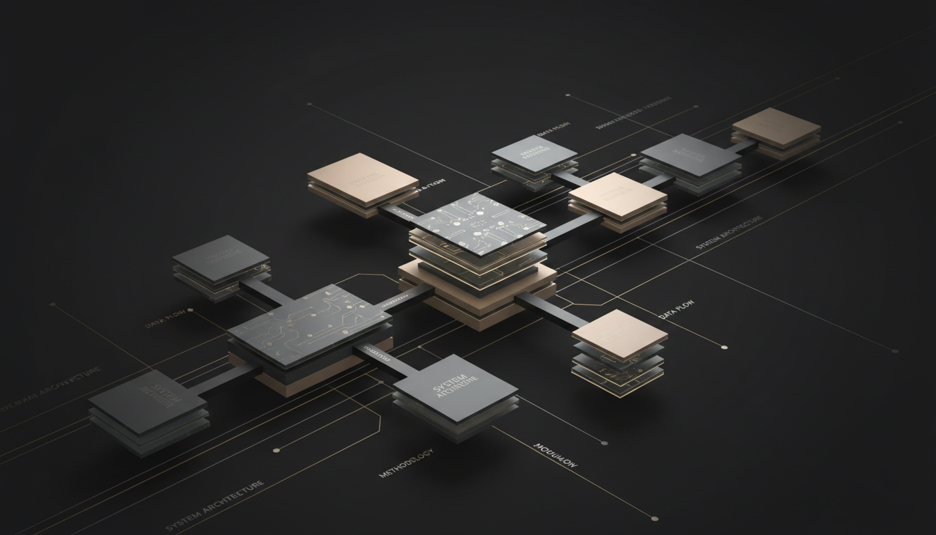
Chapter 04
Design Approach
and Details
System architecture and design methodology
Architecture
Design

Slide 22
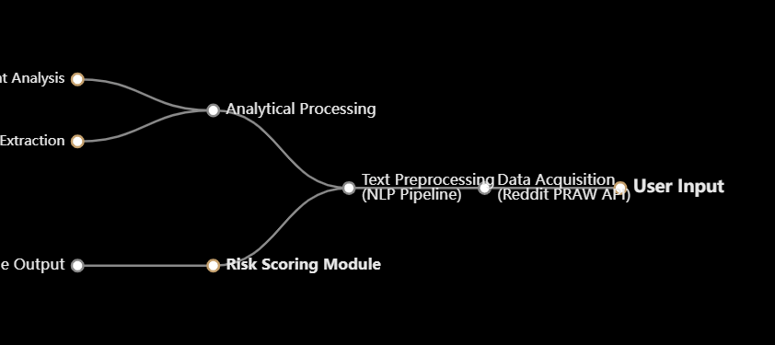
4.1 System Architecture
System Architecture
Modular and Layered Design
Core Components
The proposed system follows a modular and layered architecture that supports efficient data processing, ML-based analysis, and user interaction. The system is divided into well-defined components, allowing each module to function independently.
Data Acquisition
Reddit via PRAW API
Text Preprocessing
Architecture Flow Diagram
NLP cleaning & normalization
Analytical Processing
Sentiment & keyword analysis
Risk Scoring
Interpretable score computation
Backend & Frontend
FastAPI + React interface

Slide 23
4.2 Design
Design Philosophy
Data-Driven and Explainable Workflow
The system design focuses on a data-driven and explainable workflow, ensuring that each stage of processing contributes clearly to the final output. The design emphasizes simplicity and interpretability rather than complex black-box models, aligning with the objective of providing early warnings instead of medical diagnosis.
Modular Design
Transparency Focus
Non-Diagnostic
The design is divided into functional modules that interact through well-defined interfaces, allowing individual components to be modified without affecting overall system functionality.
Every processing stage is designed to be transparent and traceable, from data collection through risk score computation, ensuring users can understand how results are derived.
The system is explicitly designed as a support tool for health awareness, not a medical diagnostic device, ensuring ethical responsibility and appropriate use cases.
Independent development
Clear data flow
Early warning focus
Easy maintenance
Explainable outputs
Educational purpose
Scalable architecture
User trust building
Ethical boundaries
Design Diagrams
Use Case Diagram
Class Diagram
Illustrates functional requirements and user interactions
Represents static structure and component relationships

Slide 24

Chapter 05
Methodology
and Testing
Data analysis, preprocessing, model development, and evaluation approach
EDA
Preprocessing
Evaluation

Slide 25
5.1.1 Proposed Methodology
Exploratory Data Analysis
Dataset Overview
Seven Lifestyle Categories
EDA was conducted on 19,080 Reddit posts collected across seven lifestyle-related health categories, spanning nearly three years (April 2023 to January 2026).
Fitness
Diet
Substance Use
Total Posts
Time Span
Categories
19,080
~3 Years
7
Sleep
Mental Health
Content Characteristics
Diabetes
Average Characters
Average Words
Weight Management
812
145
per post
per post
Engagement Insights
Skewed distribution: Most posts with low engagement
Highest engagement: Weight management posts
Lowest engagement: Sleep-related posts
Most active: Running subreddit

Slide 26
5.1.2 Proposed Methodology
Text Preprocessing Pipeline
Structured NLP Pipeline
Following EDA, the textual data was prepared using a structured NLP preprocessing pipeline including text cleaning, tokenization, stopword removal using a customized list of 244 stopwords, and lemmatization to normalize the text.
Text Cleaning
Tokenization
Stopword Removal
Lemmatization
Remove noise and irrelevant content
Split text into individual tokens
Customized list of 244 stopwords
Normalize words to base form
Processing Results
Final Dataset Statistics
Character Reduction
Word Reduction
Final Posts
19,060
41.3%
51.2%
Total Words
1.35M
Unique Terms
40,800
Lexical Diversity
0.855

Slide 27
5.1.3 Proposed Methodology
Planned Model Development
Systematic Risk Assessment Approach
Explainability Features
After data preprocessing, the next step focuses on developing a lifestyle risk assessment model using processed Reddit text to identify patterns in user discussions that may indicate potential lifestyle-related health risks.
1
Feature Attribution
Show which features influenced prediction
2
Keyword Highlighting
Identify specific terms contributing to risk
Feature Extraction
Risk Score & Classification
3
Sentiment Breakdown
Explain emotional tone impact
TF-IDF
Score Computation
4
Score Calculation
Content representation and term importance
Combine multiple features using weighted approach to generate composite lifestyle risk score
Transparent scoring methodology
Sentiment Scores
Emotional tone capture
Risk Categories
Keyword Frequency
Lifestyle-related term counts
Low
Moderate
High
Model Selection Criteria
Performance: High accuracy and reliability
Text Statistics
ML Model Evaluation
Interpretability: Explainable predictions
Post length, lexical diversity
Compare different ML models to balance performance and interpretability
Efficiency: Reasonable training time
Scalability: Handle increasing data

Slide 28
5.2 Performance Evaluation
Performance Evaluation Strategy
Evaluation Objectives
Evaluation Approach
The proposed system will be evaluated to understand how effectively text analytics and machine learning techniques can identify lifestyle-related health risk indicators from Reddit discussions.
Baseline Comparison
Compare baseline ML models with advanced models to observe performance improvements
Evaluation Metrics
Class-wise Analysis
Accuracy
Precision
Examine performance across Low, Moderate, and High - risk categories
Overall correctness of predictions
Proportion of true positives
Consistency Check
Recall
F1-Score
Ensure system produces consistent and meaningful results
Coverage of actual positives
Harmonic mean of precision & recall
Reliability Assessment
Validate reliable early warning generation capability
Confusion Matrix Analysis
Confusion matrices will be used to analyze class-wise predictions and identify areas where the system performs well or requires improvement.

